Slide 1
SAT Test Scores
DSI-4 Project 1
Will you make it to college?
Brought to you by Zhen Ming, Kar Gim & Jasmeet

Slide 2
What are we going to be talking about today?
Background & Contextual Information
Analysis Overview
Problem Statement & Objectives
Findings
Conclusions & Recommendations

Slide 3
What is the SAT and ACT?
Here’s some background…
Standardized tests that colleges/universities in America that require for admissions and scores for these tests are measure by GPA
SAT test comprises of Evidence-Based Reading, Writing and Math
ACT test comprises of English, Math, Reading and Science
Covid-19 pandemic first hit the United States in January 2020. In order to contain the spread, lockdowns were initiated within the states in March to April 2020.

Slide 4
Analysis Overview - Who is at risk?
As members of the College Board, we are interested in enabling students achieve the SAT scores required to enter college.
In this preliminary study, we are interested in the impact of Covid-19 lockdowns has on student’s grades. More importantly, we are interested in identifying states where students are at risk of being unable to enter college.
The results of this study will be used to decide where to deploy further resources to help students at risk (if any).

Slide 5
Problem Statement - SAT vs Covid-19
The mission of the college board is to admit students for a fair and/or successful opportunity to a reputable college
With the pandemic resulting in lockdowns and tightened restrictions, learning and teaching have been affected
Conduct a preliminary study to
Verify the claims of Covid lockdowns affecting students results
Identify states at risk
Evaluate extent of impact
So how did these causations affect:
SAT scores scores trend across the timeline before and midst of a pandemic
Top performers(by state) across 2017 to 2021
Poorest performers(by state) across 2017 to 2021
Which state was most impacted by the pandemic and its restrictions
With the performance rates and list of colleges,how many students qualify to be accepted in those colleges

Slide 6
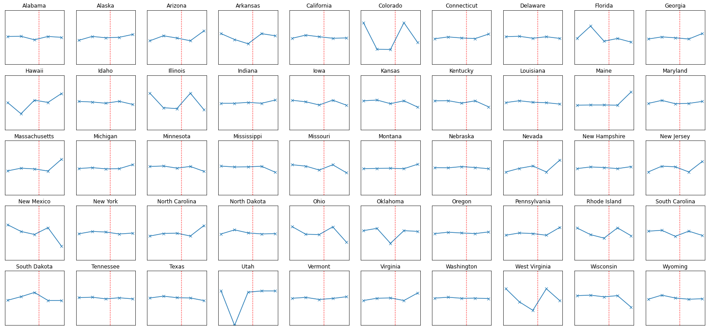
SAT Score Trend By States
Despite COVID-19 since 2020, ~34 of 50 states managed to maintain or increase their average score from 2017-2019
However in 2021, 3 states were adversely affected by COVID
New Mexico, Ohio, Wisconsin
*Charts are plotted with the same scale to depict the extent of change, relative to each state.
Notes:
All plots represent a 360-point gap between y_max and y_min

Slide 7
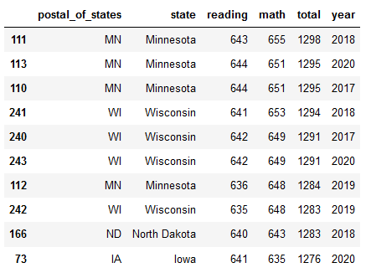
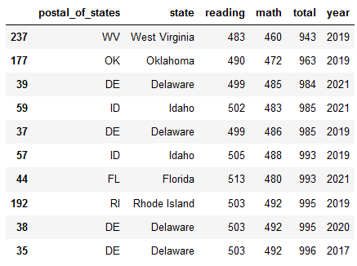
Top 10 Highest and Lowest Scores Since 2017
Top 10 High Scores😊
Top 10 Low Scores 😭
Strong performers: Minnesota and Wisconsin
8 of the 10 highest state average score
Poor performer: Delaware
4 out of 10 lowest state average score

Slide 8
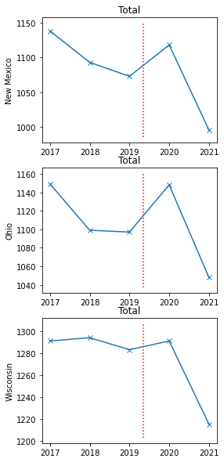
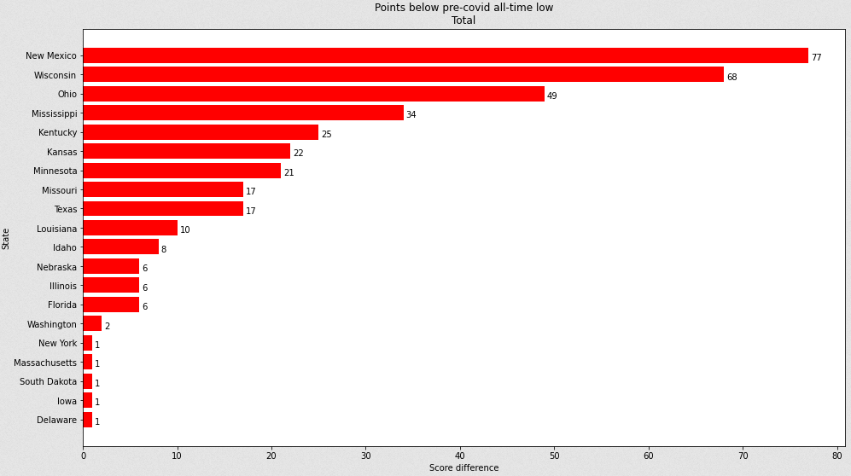
COVID Affected States
New Mexico, Wisconsin and Ohio are the top 3 most affected states, with a staggering drop of 77, 68 and 49 points respectively, below their pre-covid all-time low.
* The state is classified to be a poor performer if the 2020-2021 lowest score is below the pre-covid (2017-2019) all-time low.

Slide 9
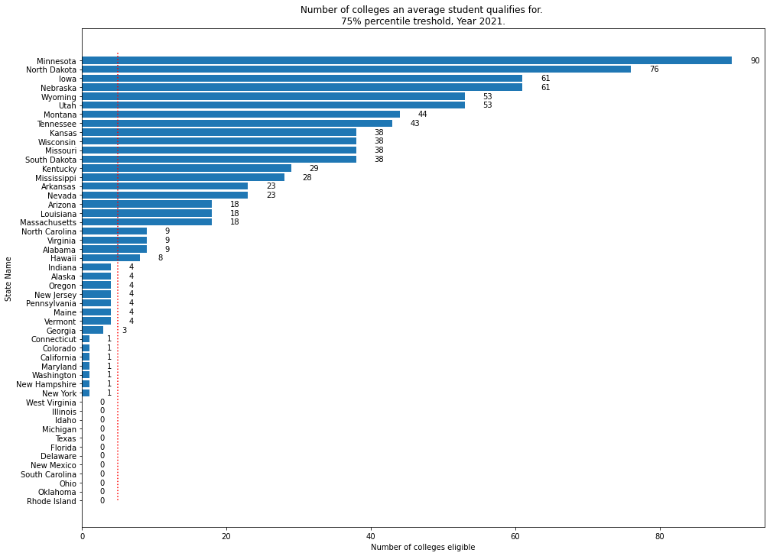
Which States Need Help?
27 states are below the threshold in year 2021
19 states urgently need help to get more students into colleges/universities
*Students scoring below the 75th percentile would be classified as having a poor chance of getting into the college.

Slide 10
Conclusion
Summary
Despite COVID, 34 states had managed to maintain a rather consistent score since 2017
Only 3 states had significant drop in scores
While COVID had resulted in new 5-year low score for 20 states, more than half of them were by 10 points or less
However, urgent attention is needed for 19 states as their students are only eligible for 1 or less colleges/universities’ popular/competitive courses
Conclusion
COVID did affect the performance of some states
But the root cause of students being unable to get a placement in universities/colleges’ popular courses is not mainly due to COVID
Factors such as education support, policies, teaching methodologies might have played a larger role since more than half of the states scores did not fluctuate too widely since 2017

Slide 11
Recommendations
To identify best practices from the top performing states such as Minnesota and Wisconsin
To identify root causes for poor performance in the 19 at-risk states.
To collect, review and monitor performance data from the 19 at-risk states moving forward.

Slide 12
End
DSI-4 Project 1

